Slide 1
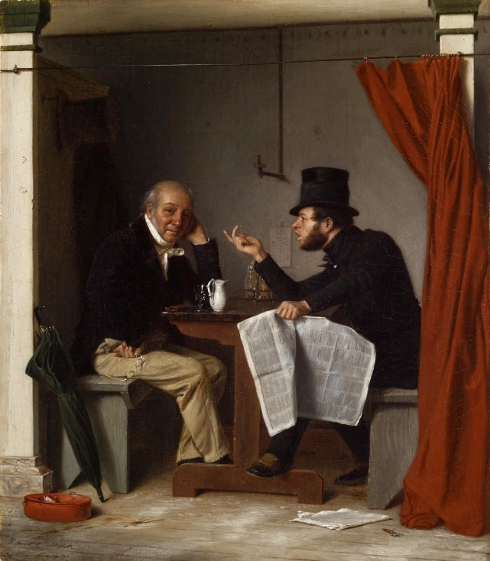
Chapter 12 – The Jacksonian Era Section 1: A New Era in Politics
Growing Spirit of Democracy
The spirit of democracy that was growing in America affected political systems as well as American ideas about social classes. Many Americans in the 1820s no longer felt the rich deserved respect.
Explain who Alexis de Tocqueville was and what his observations on American Democracy were.
He was a visitor from France who came to the U.S. in the 1930s to observe American prisons. He ended up observing much more. His observations included that the U.S. was becoming more democratic. He admired America’s democratic spirit and goals of equality and freedom.

Slide 2
Section 1 : A New Era in Politics
In what area of the US did more people gain suffrage in the 1820s? Why?
More people gained suffrage in the West in the 1820s. This was because new states were being formed and these new states had many people eager to participate in elections. Thus suffrage was given to all male 21 years and older even if they didn’t own property.
By the 1830s most eastern states dropped the requirement that voters own property; so by then, all white men 21 yrs. and older could now vote in the US
What were the limits on suffrage? (Who could not vote?)
The following could not vote: women, Native Americans, the vast majority of Af. Americans, and all slaves.

Slide 3
Section 1: A New Era in Politics
http://www.schooltube.com/video/5a1edbbfd2954d06a990/The%20American%20Presidents%20John%20Quincy%20Adams.wmv
The Disputed Election of 1824
Describe the three main candidates in the Election of 1824. Put a * next to the name of the candidate who won.
1. John Quincy Adams – *
Son of John Adams, graduate of Harvard, served as Sec’y of State, helped end the War of 1812, admired for his intelligence and high morals, didn’t like campaigning, most thought he was hard and cold.
2. Andrew Jackson –
Known for his military victories in the War of 1812, hero of New Orleans, “Old Hickory” was his nickname, grew up poor, he was admired y small farmers and others who felt left out in the growing US economy.

Slide 4
Section 1 – A New Era in Politics
3. Henry Clay –
From Kentucky, shrewd politician, Speaker of the House, skillful negotiator, less popular than Jackson.
Explain the “Corrupt Bargain”.
Jackson wins the popular vote in the Election of 1824, but none of the 4 candidates running for Presidents wins the majority of the electoral votes. As a result the House of Reps. has to decide the winner from the two candidates that had the highest number of votes (Jackson and Adams) Clay uses his influence in the House of Reps. to urge the members of the House to vote for Adams and not Jackson. After Adams wins the Presidency, he appoints Clay as his Sec’y of State. Jackson and his supported were furious and claim that Adams and Clay made a corrupt bargain and stole the Presidency from Jackson.

Slide 5
Section 1 – A New Era in Politics
An Unpopular President
What was President JQ Adams’s plan to promote economic growth?
The federal government should pay for new roads & canals so farmers could transport their goods to market.
Adams favored projects to promote the arts & sciences.
Many Americans objected to spending money on such programs because the federal government would become too powerful.
How was the Election of 1828 a bitter campaign?
1. The focus was not on the issues, but on the candidates’ personalities.
2. Jackson’s supporters renewed the charges that Adams had made a corrupt bargain after the Election of 1824 and the also said Adams was an aristocrat—member of the upper class.
3. Adams’s supporters called Jackson a dangerous military chieftain and said that if he became President he would be just like a dictator : Napoleon Bonaparte.

Slide 6
Section 1 : A New Era in Politics
Who won the Election of 1828 and why was this a victory for common people? Jackson won and it was a victory for the common people because for the first time, the politics of the common people (farmers in the S&W and city workers in the East) were important.
Explain Jacksonian Democracy.
It was the growing spirit of democracy that began with Jackson’s Presidency. Political power was now being spread to more people. It also represents a shift of political power to the West.

Slide 7
Section 1 – A New Era in Politics
New Political Parties
The following new political parties took shape in the 1830s out of the conflict between Andrew Jackson and John Quincy Adams. (Just like two other men we learned about!)
Explain the difference between a caucus and a nominating convention. Which is a more democratic way of selecting candidates for an election?
A caucus was a very undemocratic way to select candidates to run in an election. Only a few powerful party leaders met in private to choose their party’s candidate. On the other hand, at a nominating convention, delegates from all states would meet to choose the party’s candidate for President. This was a much more democratic because more people could have some influence in the nominating process.
JQ Adams & Henry Clay | Andrew Jackson
Federal gov. will spur economy | A renaming of Jefferson’s Republican Party
Eastern businessmen, some southern planters, former Federalists | Frontier farmers and workers in eastern cities

