Slide 1
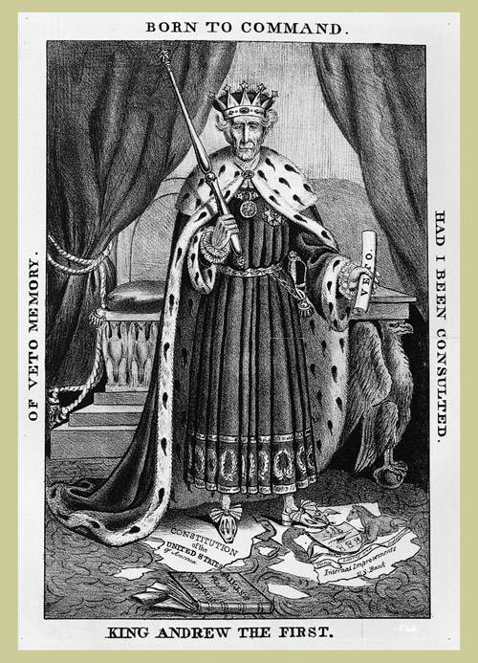
Chapter 12 - Section 2: Jackson in the White House
Andrew Jackson
https://nj.pbslearningmedia.org/resource/234e980a-fcbc-4a21-8fb7-c335d5b73064/andrew-jackson-60-second-presidents/#.WL1wAm8rLct
http://viewpure.com/dJm8X9LP3Qg?start=0&end=0
Early Life
1. When he was 13 he joined the Patriots during the Revolution. He was captured by the British and was struck by a British officer’s sword when he refused to clean the officer’s boots. This memory stayed with him for the rest of his life.
2. After the Revolution he studied law in NC and moved to TN to set up a law practice.
3.He became very wealthy by buying and selling land in GA and AL.
4. While still in his twenties he was elected to Congress.
5. He became a war hero after the Battle of New Orleans.

Slide 2
Chapter 12 - Section 2: Jackson in the White House
Andrew Jackson was a complex person. Give evidence to support this statement
Good Qualities | Bad Qualities
Inspires & leads others | Violent temper
Man of his word – is honest | Dealt with enemies harshly
Champion of the common people | Showed no mercy to the Indians
 | Acted more like a king than president

Slide 3
Chapter 12 - Section 2: Jackson in the White House
The Spoils System
What did Jackson do after taking office as President?
He fired many government employees and replaced them with his own supporters.
How did Jackson defend his use of the spoils system?
He said he was serving democracy by letting more citizens take part in government. This would stop a small group of wealthy men controlling the government. He wanted to see ordinary Americans fill gov. jobs.
Explain what a Jackson supporter meant when he said “To the victor belongs the spoils.”
He meant that since Jackson won the Presidency and was the “victor” and the profit or the benefits of winning belong to him. Therefore, as victor, Jackson can give the “spoils” or jobs to whomever he wants.
Explain what the “Kitchen Cabinet” was. Who was part of this group of advisers?
This was a group of unofficial advisers who met informally with Jackson in the White House kitchen. These included Democratic leaders and newspaper editors. They had a good sense of the nation’s moods.

Slide 4
Chapter 12 - Section 2: Jackson in the White House
The Bank War
http://viewpure.com/o0pc7eH41vY?start=0&end=0
List some reasons why President Jackson and the Democrats despised the Bank of the United States.
It was undemocratic.
He didn’t like that wealthy men, like Nicholas Biddle, ran the Bank.
He felt that the Bank benefitted only the rich.
He didn’t like how Biddle and the Bank controlled Congress.
He felt it was too powerful.

Slide 5
Chapter 12 - Section 2: Jackson in the White House
Describe how Mr. Biddle (the Bank’s President), Henry Clay, and Daniel Webster tried to save the Bank of the United States (BUS) and defeat Jackson in the Election of 1832.
Biddle, Clay and Webster were worried that Jackson might destroy the Bank, so they decided to make the renewing of the Bank’s charter one of the issues in the upcoming Presidential Election of 1832. In this election Henry Clay was running against Andrew Jackson. The Whig Party (Clay’s party) believed that most Americans supported the Bank of the U.S. They felt that if Jackson vetoed the bill to renew the Bank it would anger voters and they would not vote for Jackson and he would lose the election.
What were Jackson’s two reasons for vetoing the Bank bill?
1. He felt the Bank was unconstitutional.
2. He felt that the bank helped aristocrats or the wealthy at the expense of the common people.

Slide 6
Chapter 12 - Section 2: Jackson in the White House
Who won the Election of 1832?
Jackson won.
With the Bank bill vetoed and without a new charter, the BUS would have to close. Explain how Jackson saw to it that the BUS would cease to function even before the charter ran out in 1836. What did Jackson and Sec’y of the Treasury Roger Taney do to ensure the bank could no longer function?
Jackson did not want to wait until the charter ran out in 1836; he wanted to destroy the Bank immediately. So, he ordered his Secy’ of the Treasury, Roger Taney, to stop putting government money into the BUS. Instead, Taney ordered government money be deposited into state banks, called “pet banks” because Taney and his friends controlled them. The loss of funds made it very difficult for the BUS to continue to function.
What happened when the Bank finally closed in 1836?
When the bank finally closed in 1836, an economic crisis in the U.S. was already brewing.

