Slide 1
Ch. 12 Section 3 – The Nullification Crisis: Webster vs. Calhoun http://viewpure.com/TK8PHLLdO2k?start=0&end=0
A Crisis over Tariffs
Congress passes the highest tariff in history (Tariff of Abominations 50%!! ) in 1828.
This high tariff protected manufacturers from foreign competition.
Most manufacturers were from the North.
Southern planters were hurt by the tariff because they sold their cotton in Europe and bought European goods in return. The high tariff meant that they had to pay more for these imports.
Many southerners felt the tariff was unconstitutional.

Slide 2
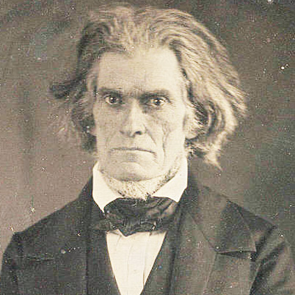
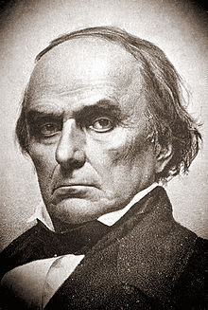
Calhoun v. Webster
John C. Calhoun
Leads fight against the tariff.
Claims a state has the right to nullify or cancel a federal law that it considered to be unconstitutional.
Supports states’ rights.
Claims that states have final authority because they created the Constitution.
Daniel Webster
Attacks the idea of nullification.
Claims the Constitution united the American people, not just the states.
Claims that if states can nullify federal laws, then the nation would fall apart.

Slide 3
Nullification Crisis http://viewpure.com/FIzTa2qLKqg?start=0&end=0
A new lower tariff is passed in 1832.
South Carolina reacts by passing the Nullification Act, declaring the new tariff illegal and threatens to secede.
President Jackson responds to SC’s actions by asking Congress to pass the Force Bill, which allowed him to use the army, if necessary, to enforce the tariff.
H. Clay proposes a compromise tariff – a lower one (33%).
Calhoun supports the compromise tariff.
South Carolina repeals the Nullification Act and the Nullification Crisis is over. Tensions between N &S will last for years, though.

