Slide 1
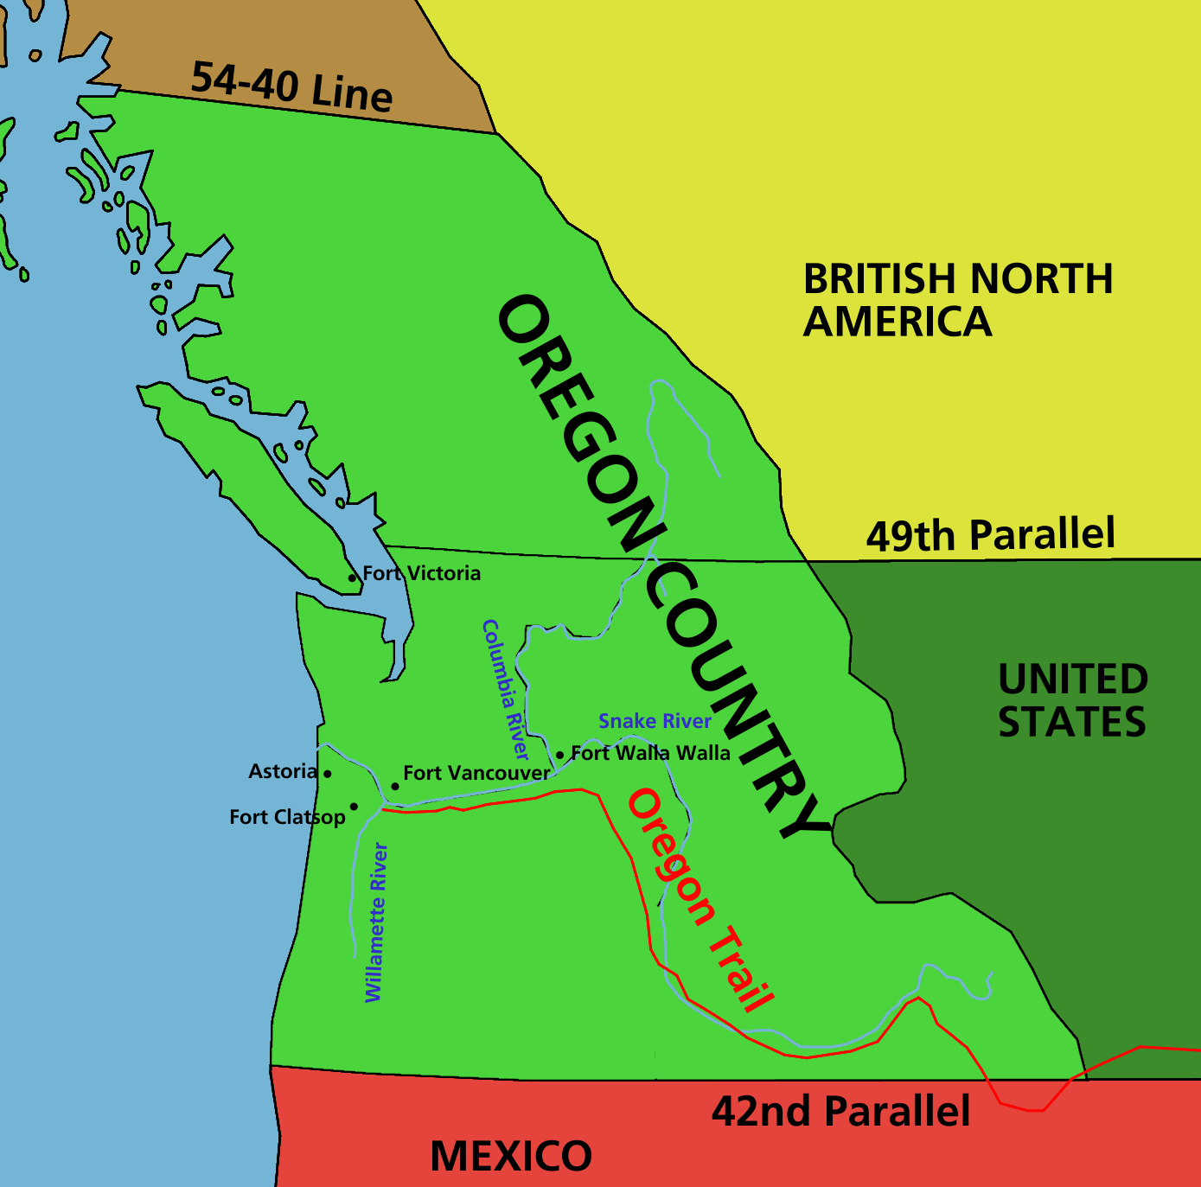
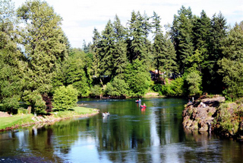
Chapter 13 - Westward Expansion Section 1: Oregon Country
While reading Oregon Country, you will focus on the following Objectives:
What was the appeal of Oregon Country and the lands in the Far West?
How did mountain men contribute to exploring and settling the Far West of the US?
What role did missionaries play in Oregon?
What were hardships faced on wagon trains to the West?
https://www.youtube.com/watch?v=UF_DMbsK2Dk

