Slide 1
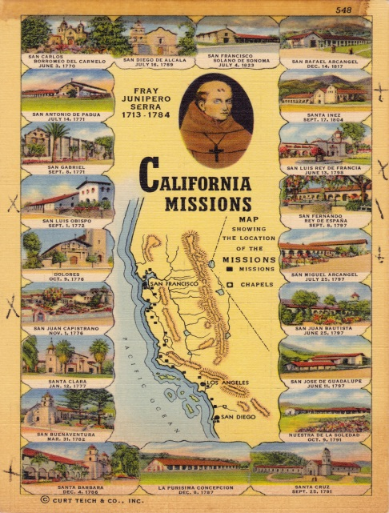
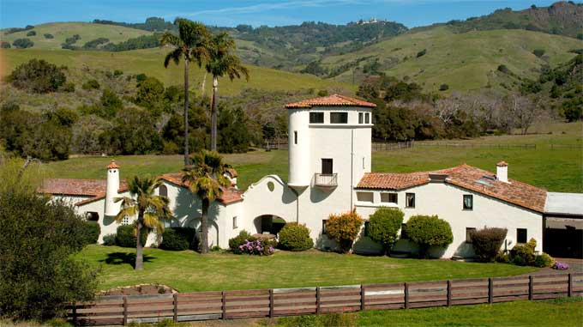
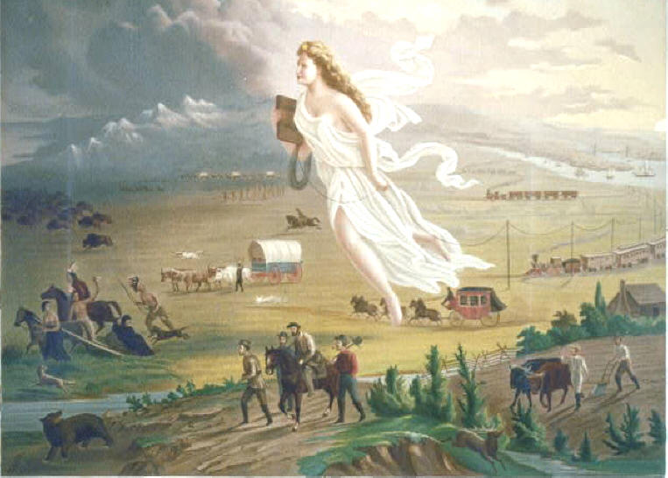
Chapter 13 – Westward Expansion Section 3: California and the Southwest
While reading California and the Southwest, you will focus on the following Objectives:
Why did Americans begin to take an interest in the New Mexico Territory in the 1840s?
Describe life for the Native Americans on California’s missions and ranches.
Why did many Americans support the idea of western expansion in the 1840s?
https://www.youtube.com/watch?v=YLmUhT9QOlE

