Slide 1
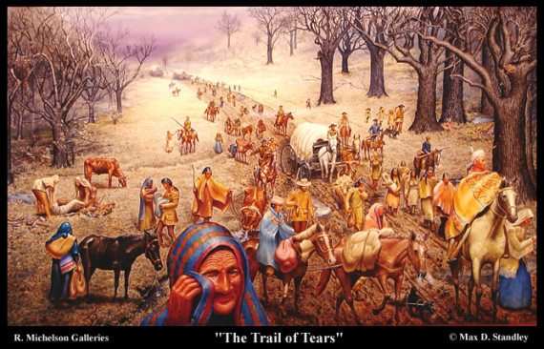
Chapter 12 -Section 3: Indian Removal
Tragedy for Native Americans
What key Native American tribes inhabited the Southeast of the US in the early 1800s?
The Creek, Choctaw, Chickasaw, Cherokee, and Seminole tribes.
Why did American settlers want Native American land?
Their land was fertile and ideal for growing cotton.
Where did Jackson set aside land for the Native Americans?
Beyond the Mississippi River

Slide 2
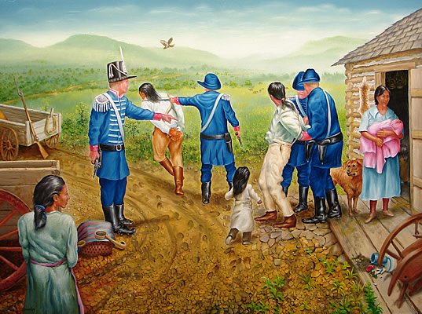
Chapter 12 -Section 3: Indian Removal
Explain why most Native Americans did not want to leave their land.
The Cherokee had started to adapt to the customs of the US in order to preserve their way of life. They even created a government and a legal system that blended European and Cherokee traditions. The Choctaw thought they’d be spared because they had helped the US during the War of 1812.
When Georgia claimed the right to make laws for the Cherokee tribe, the Supreme Court ruled in Worcester v. Georgia that Georgia’s action were unconstitutional and stated that Native Americans were protected by the US Constitution. Explain what Jackson did in response to the Court’s ruling.
He refused to enforce the Court’s decision. In the case of the Cherokees and Georgia Jackson supported states’ rights and said the federal government could not stop Georgia from extending its authority over Cherokee land.

Slide 3
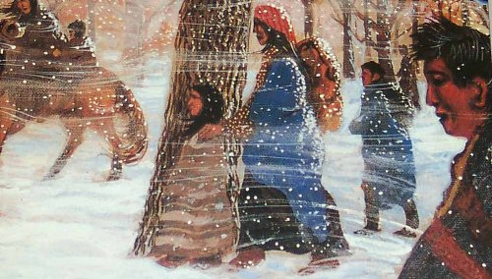
Chapter 12 -Section 3: Indian Removal
Explain what the Indian Removal Act did to Native Americans.
It forced many Native Americans to move west of the Mississippi River.
In 1838, the US Army drove over 15,000 Cherokee westward to the new Indian Territory in present day Oklahoma. Most of this land was desert-like. The Cherokee traveled hundreds of miles over the course of several months. Thousands of Cherokee died. This awful journey became known as the Trail of Tears.
http://www.schooltube.com/video/10ab73bc9f1d4dc89014/AndrewJackson-TrailofTears/

Slide 4
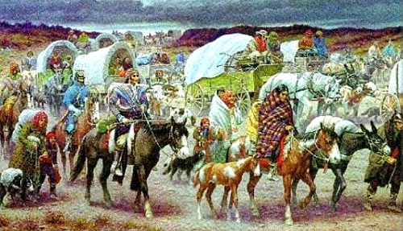
Chapter 12 -Section 3: Indian Removal
What tribe was forced to leave Florida after two long wars with the US Army?
The Seminoles.
The Sauk and Fox tribes from Illinois, led by a brave warrior called Black Hawk fought against US Army troops and volunteer militia. Black Hawk and his warriors were defeated at the Battle of Bad Axe. Black Hawk surrendered and the Native American resistance collapsed.

Slide 5
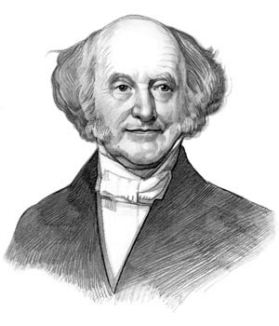
Chapter 12 – Section 3: Martin Van Buren and Hard Times
Martin Van Buren and Hard Times http://viewpure.com/xfRx6Xz0NBM?start=0&end=0
http://viewpure.com/CpEluRvJcjc?start=0&end=0
Explain what happened during the Panic of 1837.
After the BUS closed, state banks could lend money without limit. To meet the demands of all these new loans, state banks printed more and more money. Often the paper money was not backed by silver or gold. Jackson had ordered that anyone buying public land had to pay for it with gold or silver, so many land speculators began rushing to state banks to exchange their paper money for gold and silver. Many banks did not have the gold and silver to back all the paper money that was in circulation, so many were forced to close.
The US plunged into an economic depression that lasted three years. Why did many Americans blame Martin Van Buren and his policies for the economic depression?
Van Buren believed in laissez faire and felt the government should play a small role in the economy. So he did very little and as the depression wore on, he became more and more unpopular.

Slide 6
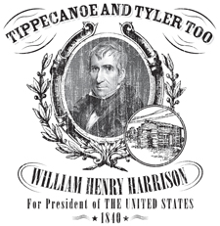
Chapter 12- Section 3: Campaigns of 1840 http://viewpure.com/1hzRZLOQif0?start=0&end=0
Who were the candidates for President in the Election of 1840?
Democrats: Martin Van Buren Whigs: William Henry Harrison
How did the Whigs try to appeal to voters when they presented Harrison as their candidate for President?
They focused on his war record and created an image for him as a “man of the people”. They boasted he was born in a log cabin and presented him as a humble farmer, when he was actually rich and well-educated.
Explain how the campaigns of 1840 reflected a new sort of politics?
Both parties competed for votes with rallies, banquets, and entertainment. They also used mudslinging, which is name-calling, half-truths and lies to win votes.
Explain how the campaigns of 1840 reflected a new sort of politics?
Both parties competed for votes with rallies, banquets, and entertainment. They also used mudslinging, which is name-calling, half-truths and lies to win votes

Slide 7
Chapter 12 – Section 3: Campaigns of 1840
Who won the presidential election? Harrison won.
What did the Whigs’ program for the running of the government include?
Creating a new BUS, improving roads and canals, and demanding a high tariff.
Why were the Whigs’ hopes for the government dashed?
Harrison dies of pneumonia within a month of taking office.
Who became President when Harrison died within a month of taking office? Explain how the new President failed to live up to Whig expectations? http://viewpure.com/qgomfO_unH8?start=0&end=0
John Tyler becomes President and as a former Democrat he opposed some of the Whig plans for developing the economy. For example, he vetoed the bill to recharter the BUS. His Cabinet resigned and the Whigs threw him out of the party.

