Slide 1
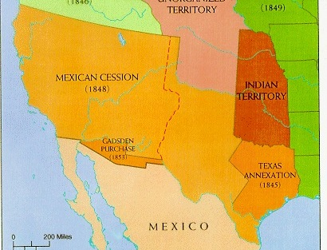
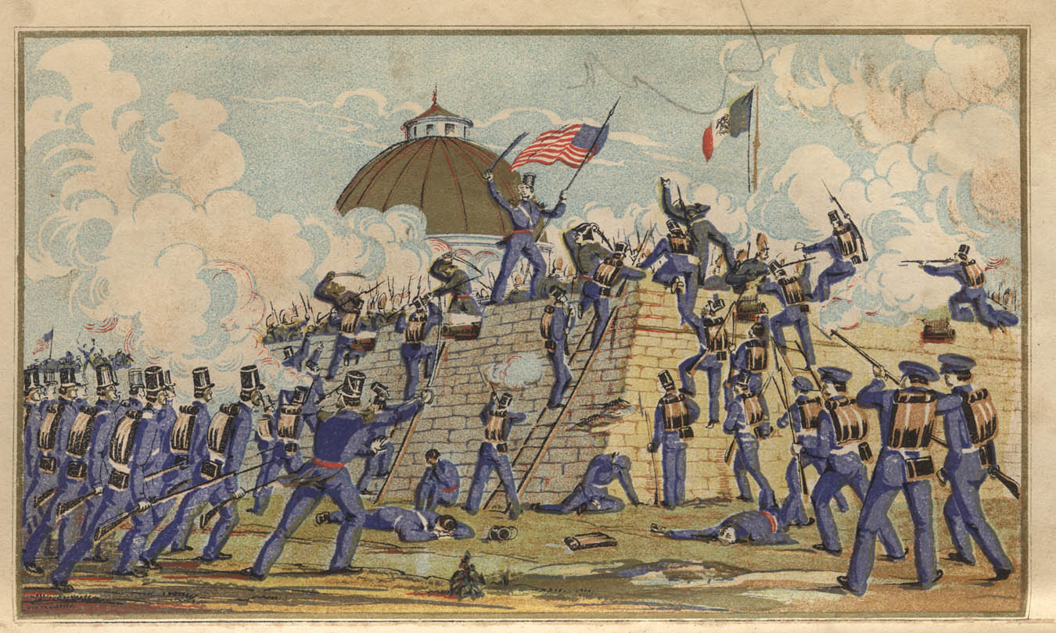
Chapter 13 – Westward Expansion Section 4: The Mexican War
While reading The Mexican War, you will focus on the following Objectives:
How did the United States gain Oregon and Texas?
What were the causes and results of the Mexican War?
How did a mix of cultures shape California and the Southwest?
https://www.youtube.com/watch?v=n13fnQcw4Rc

