Slide 1
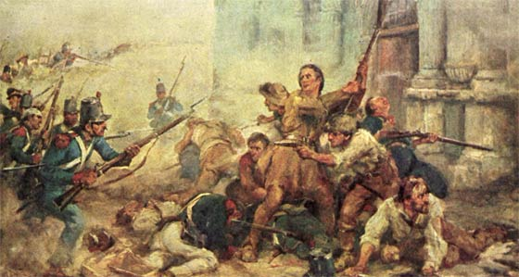
Chapter 13 – Westward Expansion Sect. 2 – The Republic of Texas
While reading The Republic of Texas, you will focus on the following Objectives:
Why were there problems/conflicts between Americans who had settled in Texas and the Mexican government?
How did Texas gain its independence form Mexico?
How did the siege at the Alamo affect the Texans?
What were the challenges faced by the newly established Lone Star Republic?
http://www.history.com/topics/alamo/videos/deconstructing-history-alamo

