Slide 1
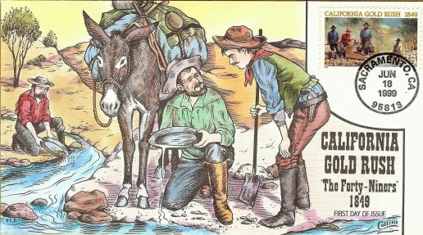
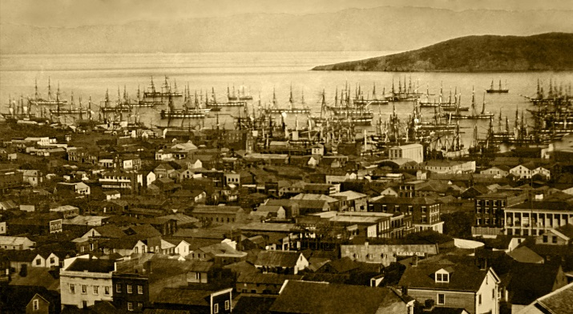
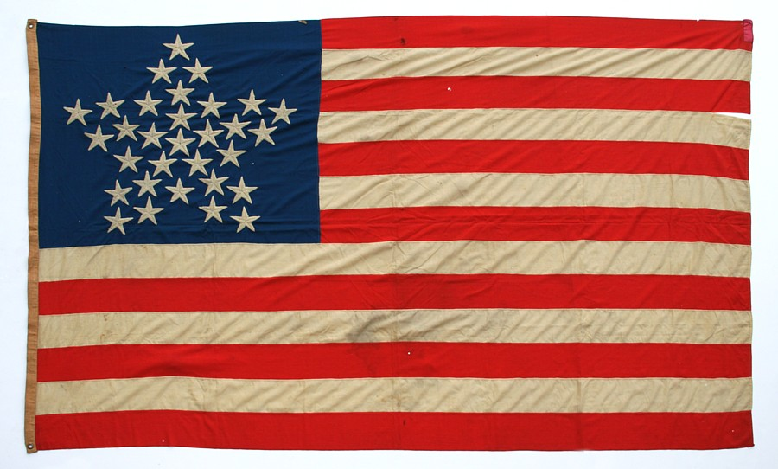
Chapter 13 – Westward Expansion Section 5: Americans Rush West
While reading Americans Rush West, you will focus on the following Objectives:
Why did the Mormons decide to move to Utah Territory?
How did the Gold Rush Affect life in California?
What were the main groups of people, in addition to white Americans, who moved into the new state of California, and what obstacles did they face?
https://www.youtube.com/watch?v=Oi9i4agGmkw&feature=related

