Slide 1
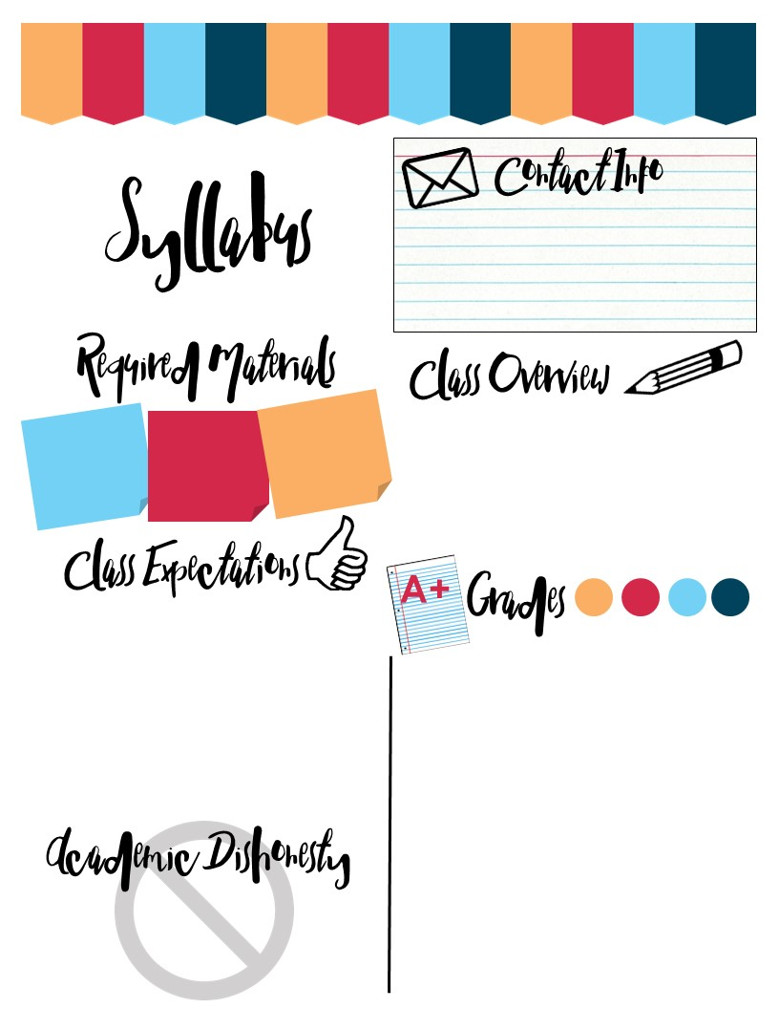
7th Grade Social Studies
Mrs. Largiader
Room: 26
Email: mlargiader@littlesilverschools.org
2017 - 2018
A binder to keep track of notes and work.
2 folders to store notes in.
We will be studying US History from 1754 (The French & Indian War) through the 1870’s (Reconstruction). We will take notes and study timelines & maps. We’ll engage in critical thinking/reading/writing, as well as class discussions & debates. We will also keep abreast of current events! So… STAY TUNED!!
Pen, pencil,
colored pencils when needed.
Be KIND, stay ENGAGED, & work HARD.
LET’S STRIVE TO DEMONSTRATE :
Tolerance
Cooperation
Respect
Compromise
Integrity
Courtesy
Hard Work
TOGETHER WE WILL BRING HARMONY TO OUR CLASSROOM, NATION & WORLD!
Grade Set-up
Academic dishonesty will NOT be tolerated under any circumstances. Cheating, copying, or plagiarism of any form will result in failure of the assignment, disciplinary referral, and parent contact.

